Slide 1
Machine Learning for Predicting Hospital Readmission
Yung Chou
12/12/2018

Slide 2
Agenda
Motivation
Data Set
Data Preparation
Machine Learning Model
Results
Lessons Learned

Slide 3
Motivation
Personal interests
Relevance
Indication to health care quality and a patient’s experience
Interpretation and implementation
Public health
Hospital Readmissions Reduction Program (HRRP)
Center for Medicare & Medicaid Services (CMS)
An important and on-going topic
Long-term health care quality and cost-effectiveness

Slide 4
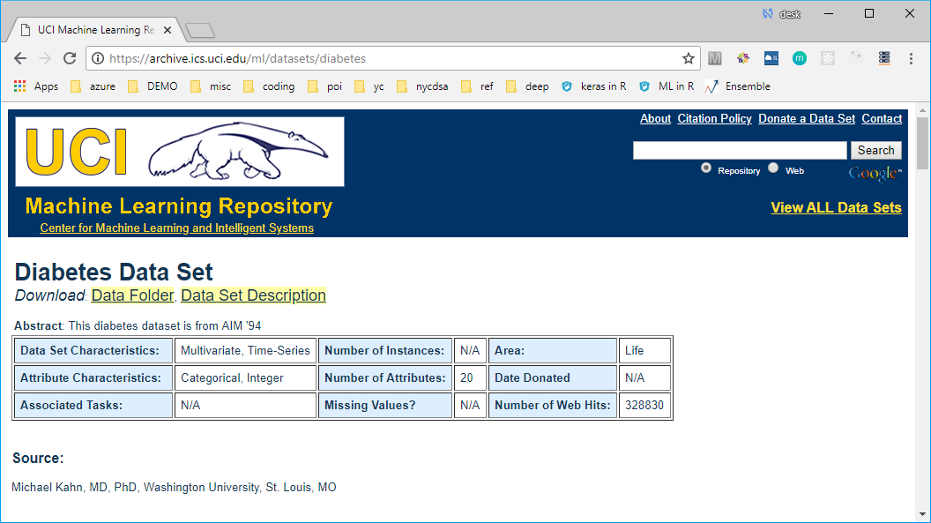
Data Set

Slide 5
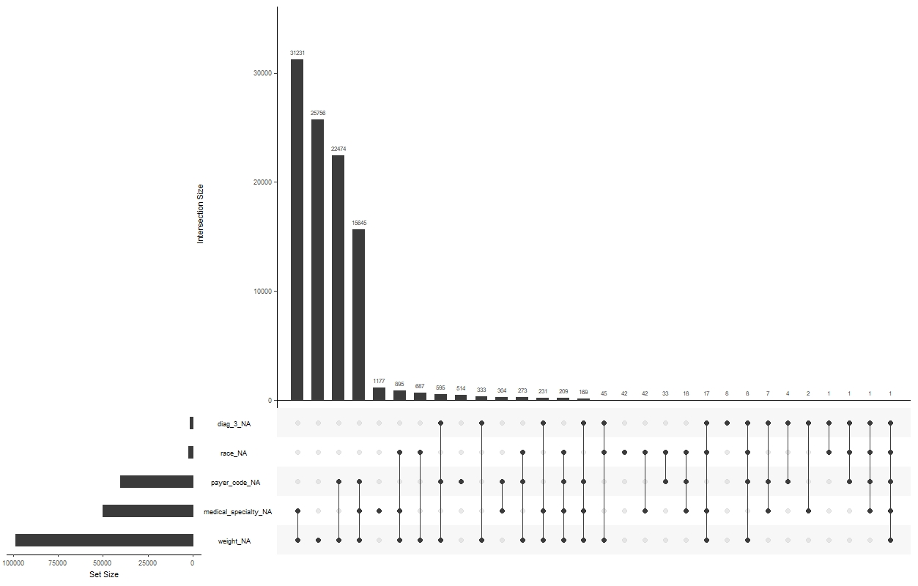
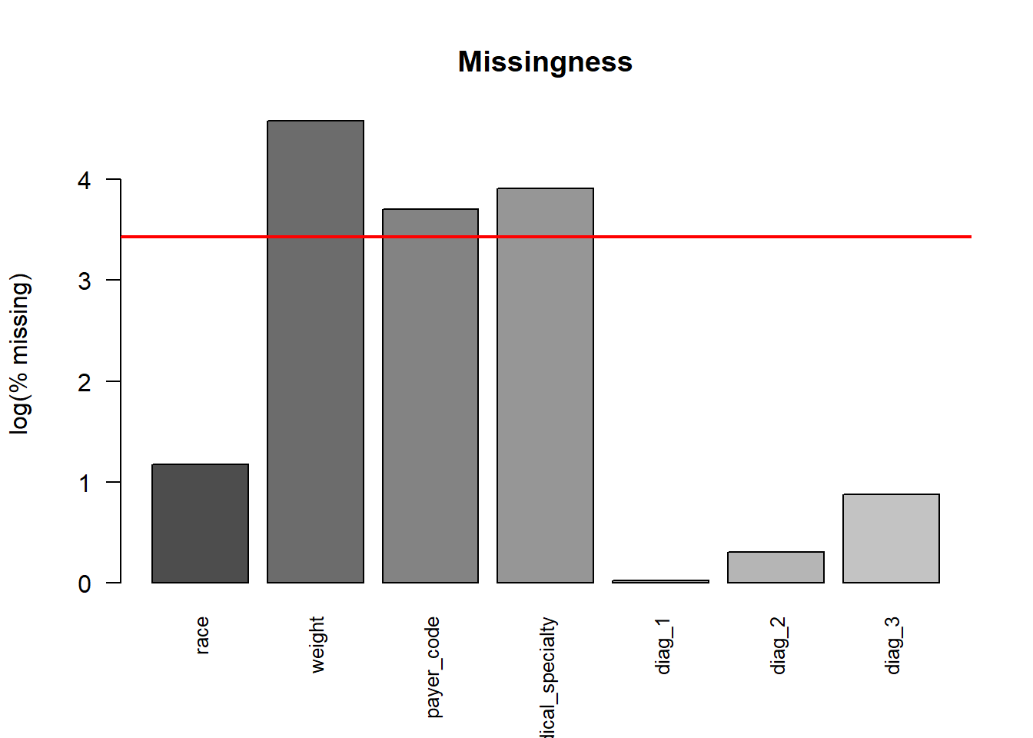
Missingness

Slide 6
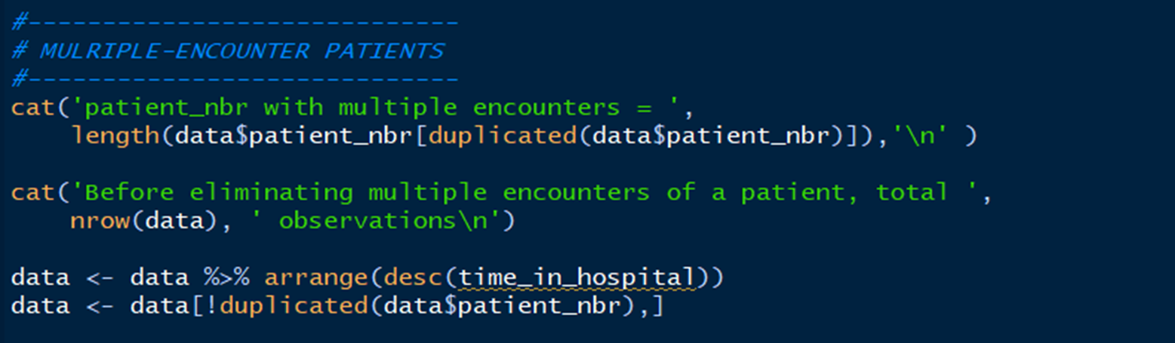
Near zero-variance variables
Multiple-encounter patients

Slide 7
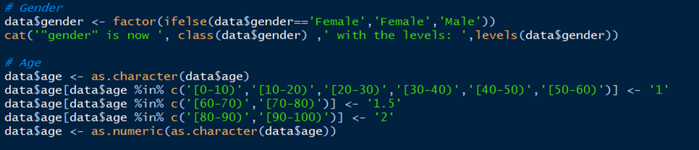
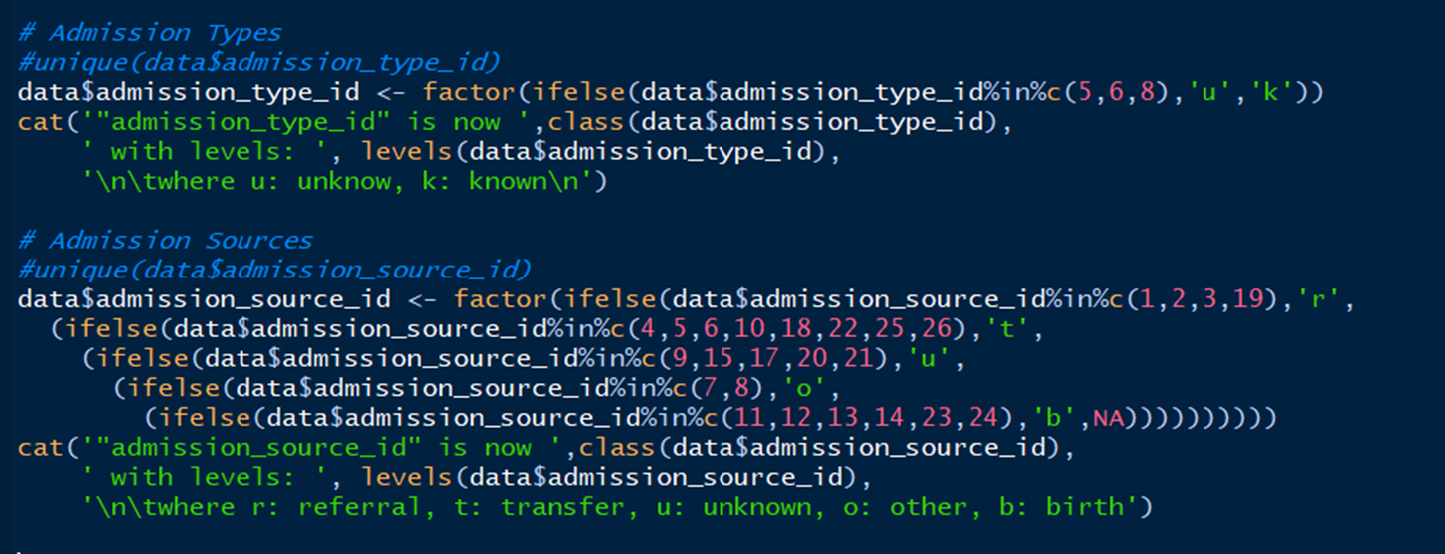

Slide 8
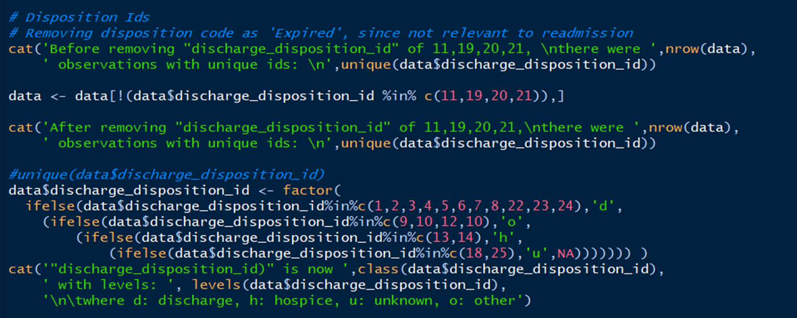

Slide 9
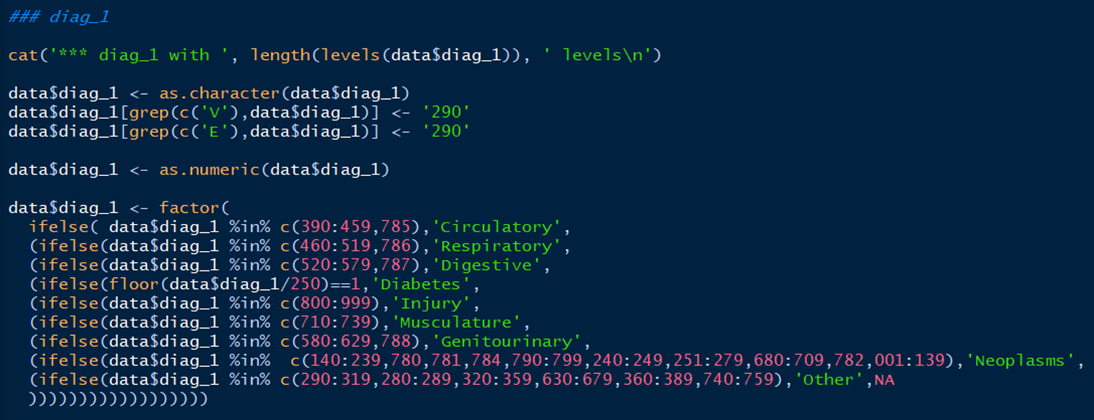
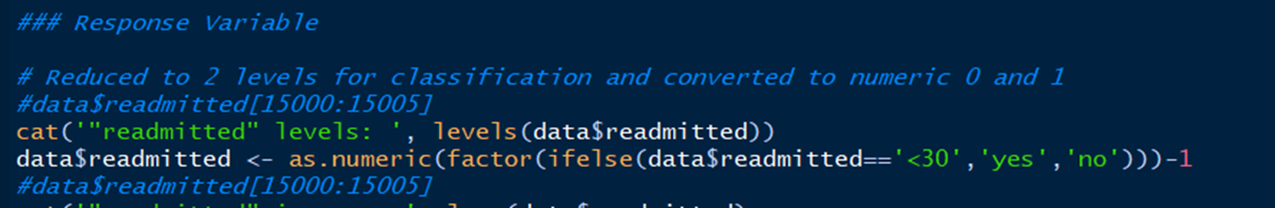

Slide 10
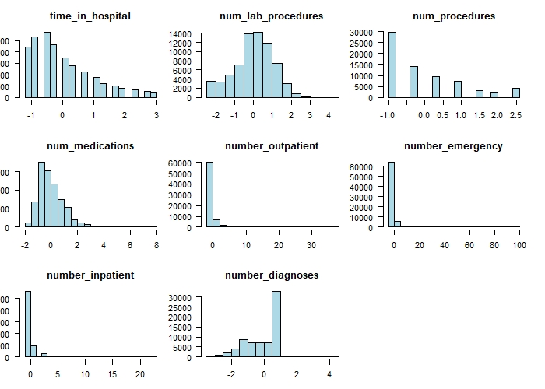
Numeric variables

Slide 11
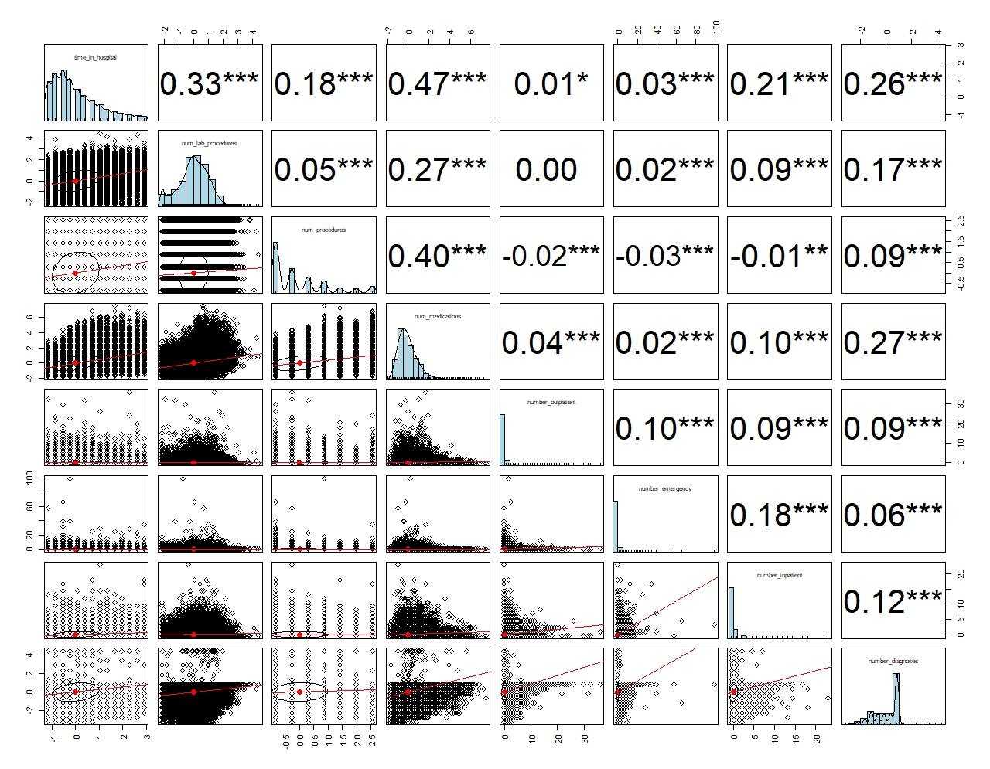

Slide 12
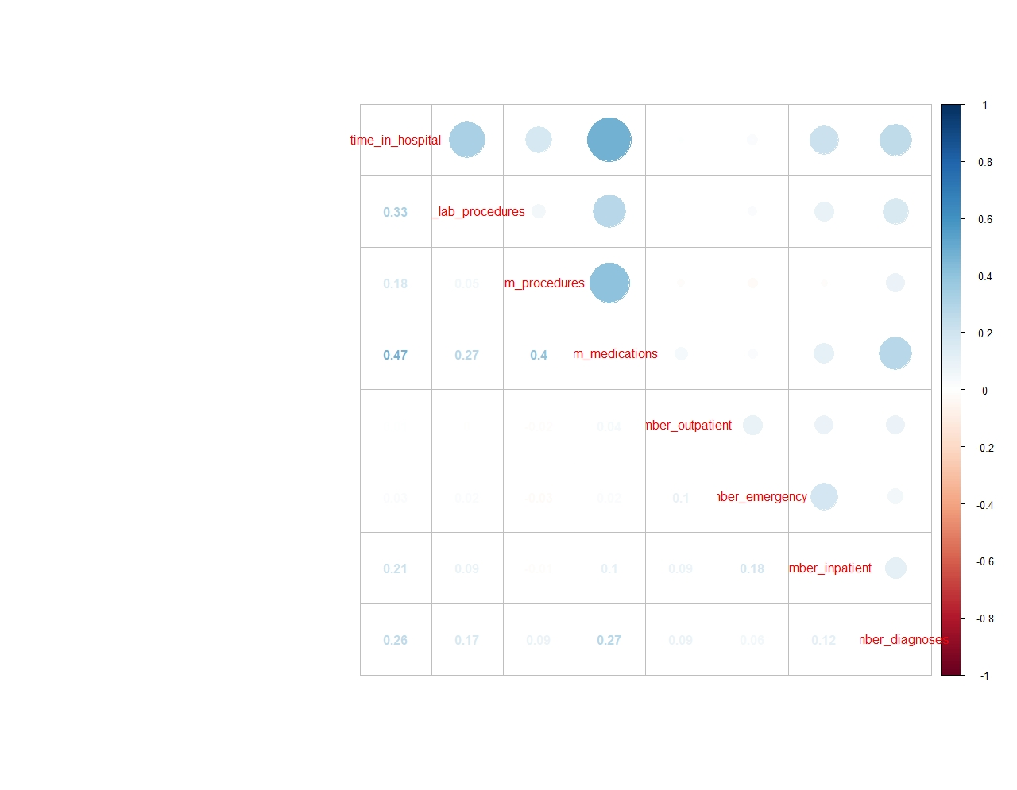

Slide 13
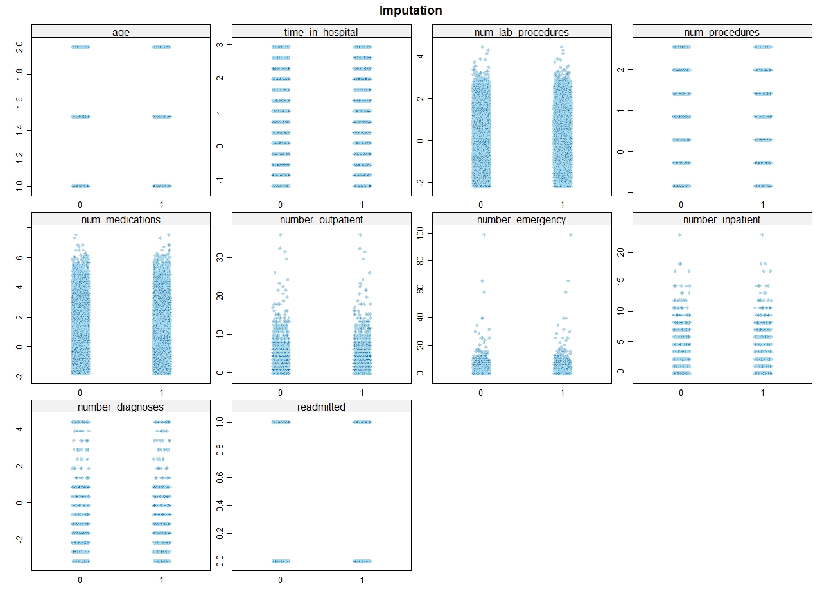

Slide 14
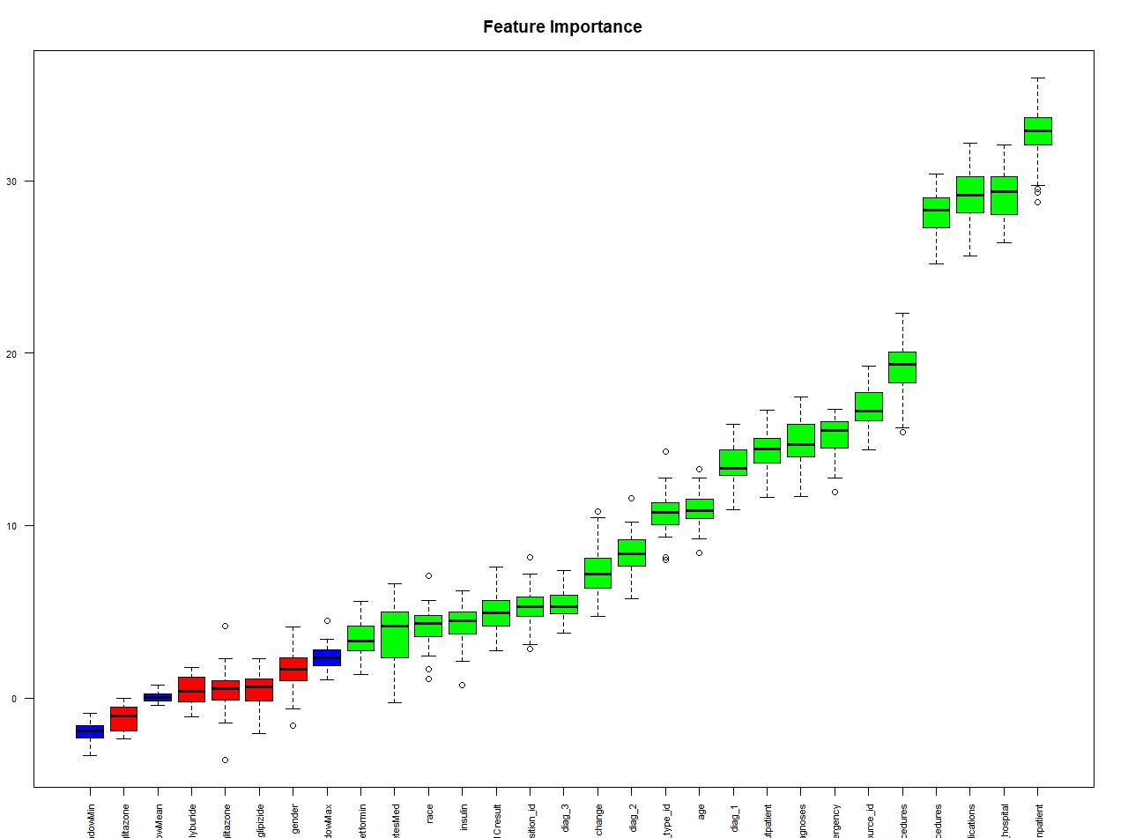
Boruta selected features
"race“
"age“
"admission_type_id" "discharge_disposition_id" "admission_source_id" "time_in_hospital"
"num_lab_procedures" "num_procedures" "num_medications"
"number_outpatient" "number_emergency" "number_inpatient"
"diag_1“
"diag_2“
"diag_3"
"number_diagnoses"
"A1Cresult“
"metformin"
"insulin“
"change“
"diabetesMed"

Slide 15

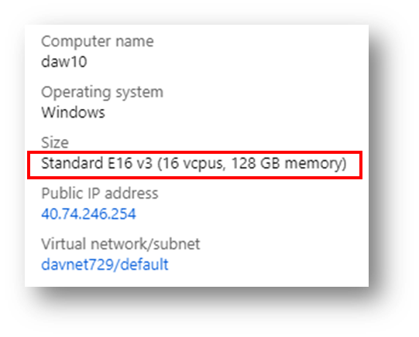

Machine Learning
SuperLearner
Various algorithms
Ensemble models

Slide 16
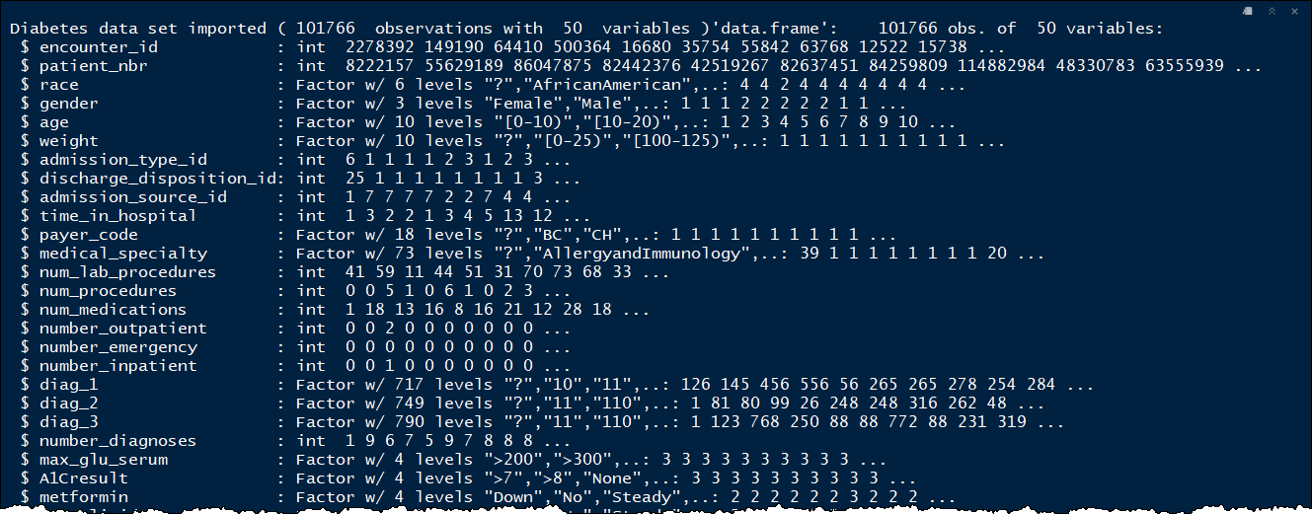

Slide 17
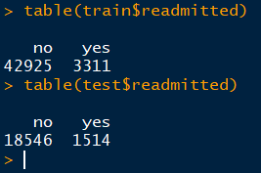
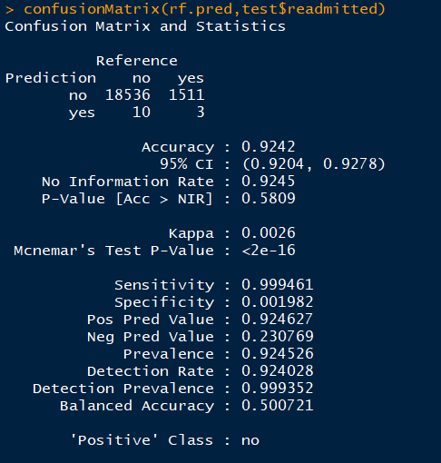
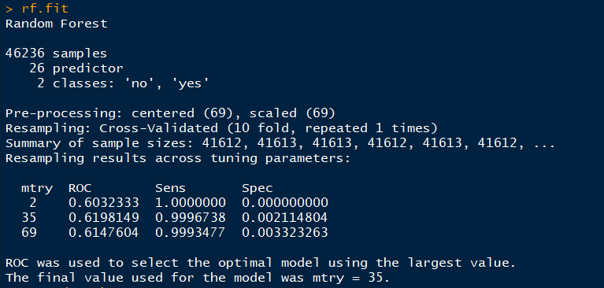
There must be a message…

Slide 18

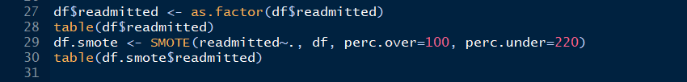
SMOTE
Highly unbalanced data
SMOTE (Chawla et. al. 2002)
To artificially generate new examples of the minority class
The majority class examples also under-sampled, leading to a more balanced dataset

Slide 19
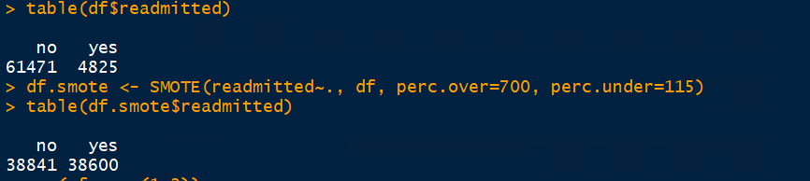
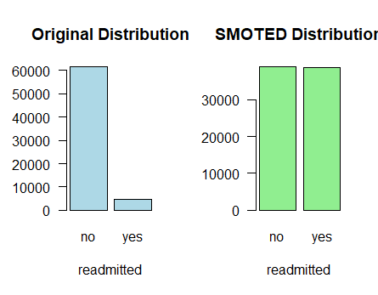

Slide 20
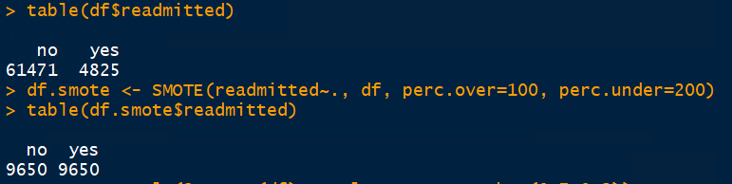
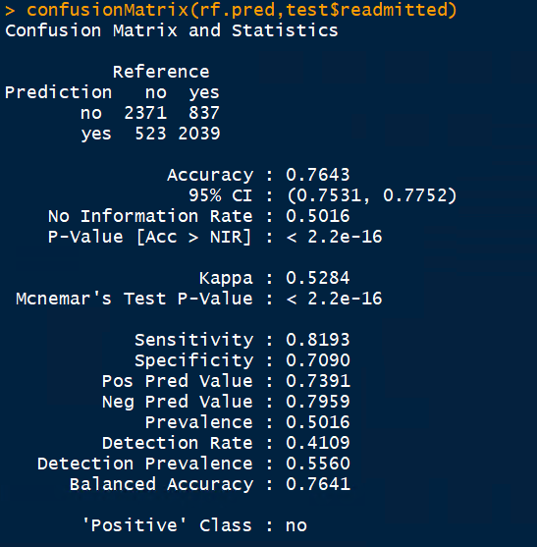

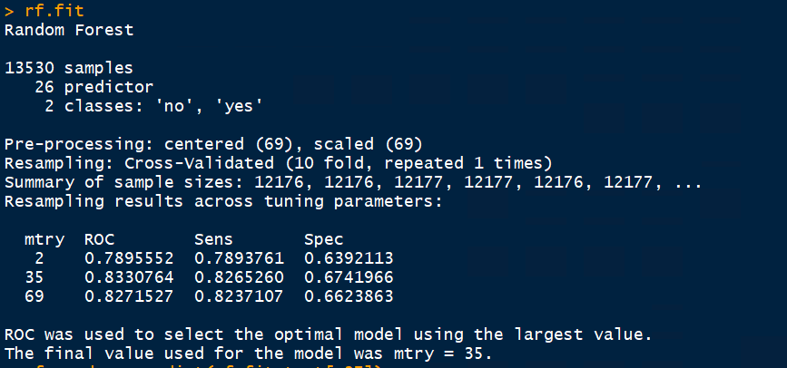
smote data
method = ‘rf’
5-fold cv

Slide 21
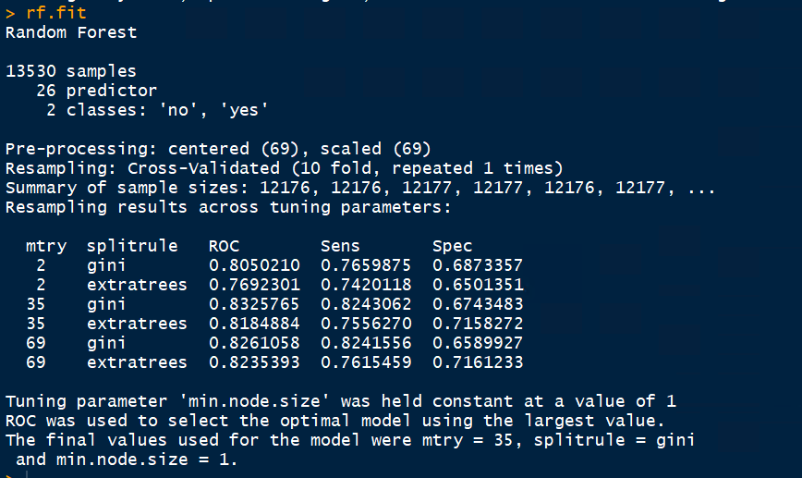
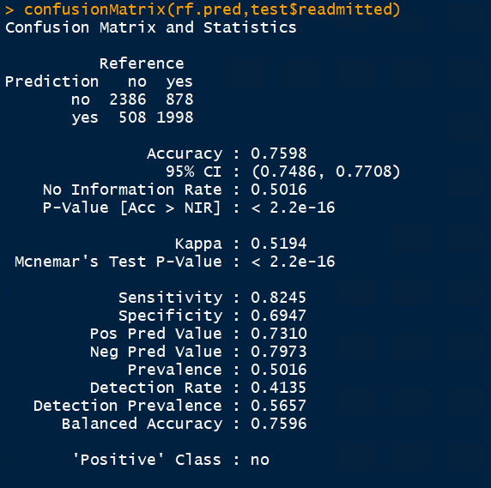
method = ‘ranger’
10-fold cv

Slide 22
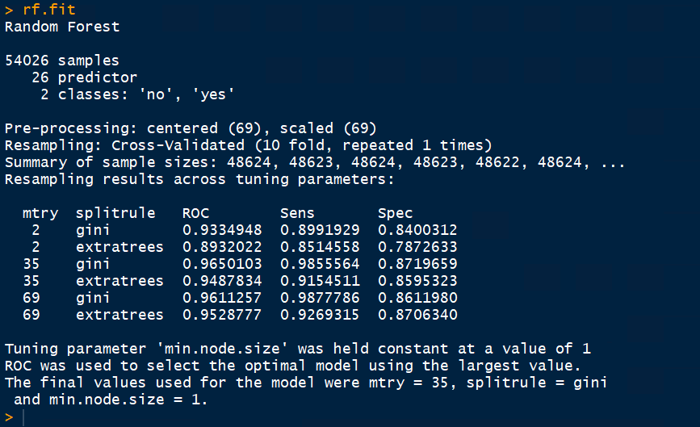
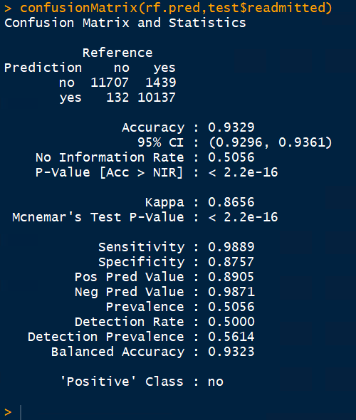
method = ‘ranger’
10-fold cv

Slide 23
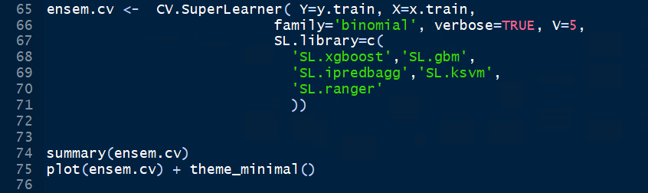
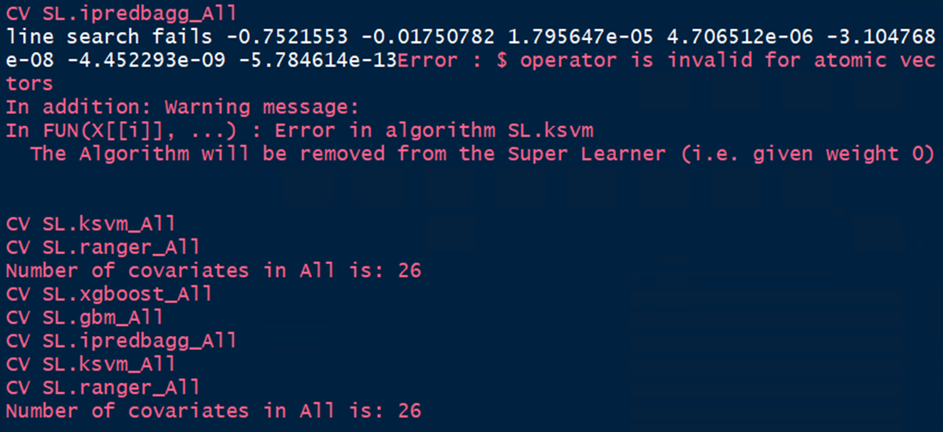
Ensemble Learning

Slide 24
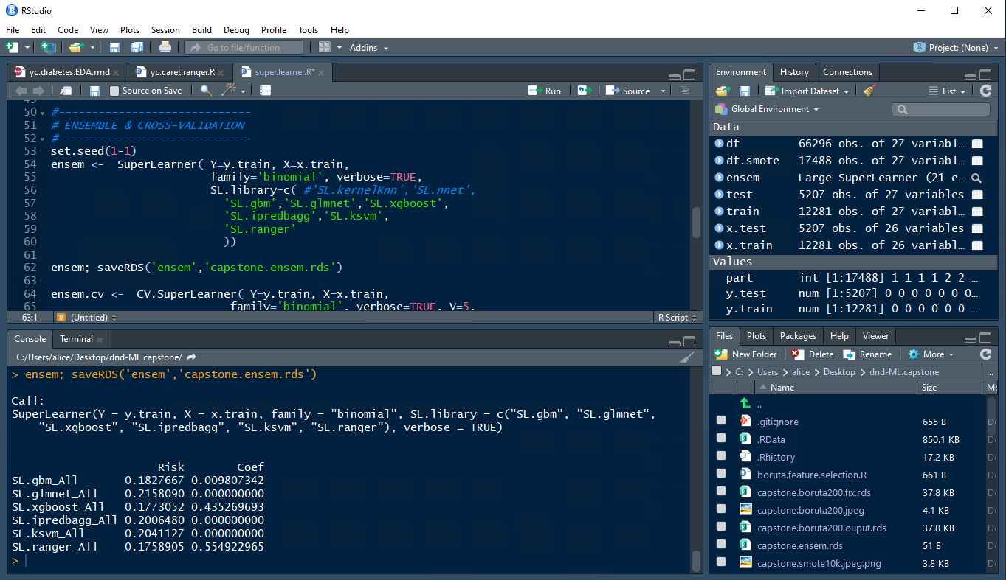

Slide 25
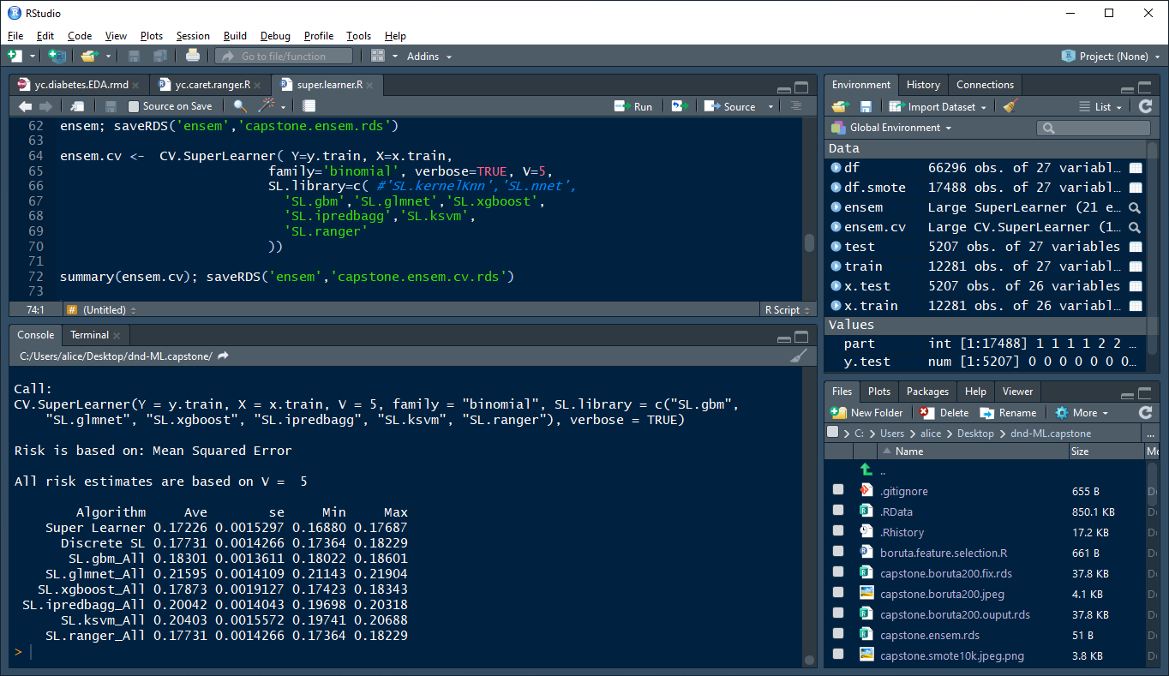

Slide 26
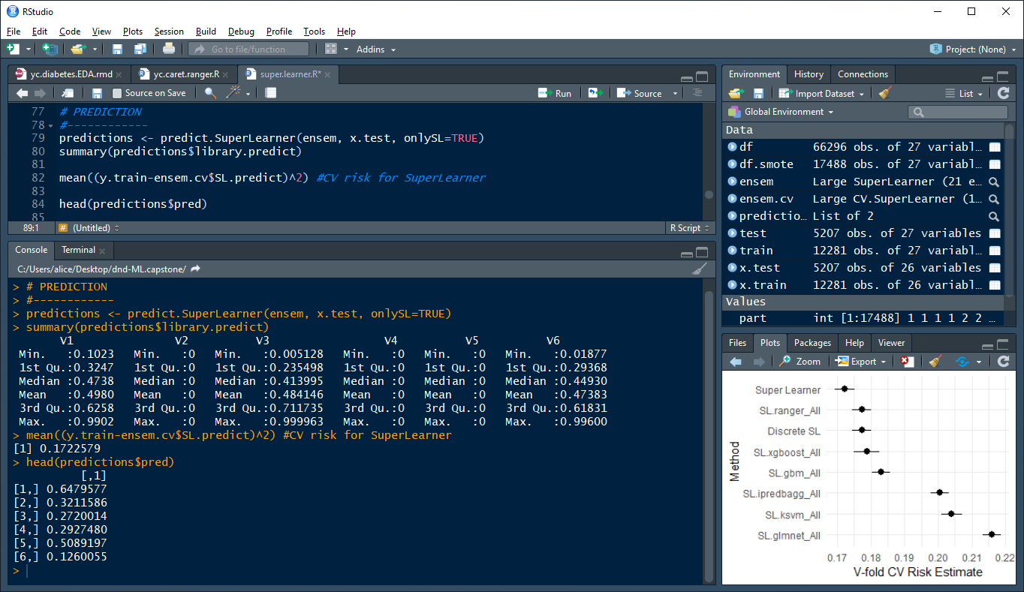

Slide 27
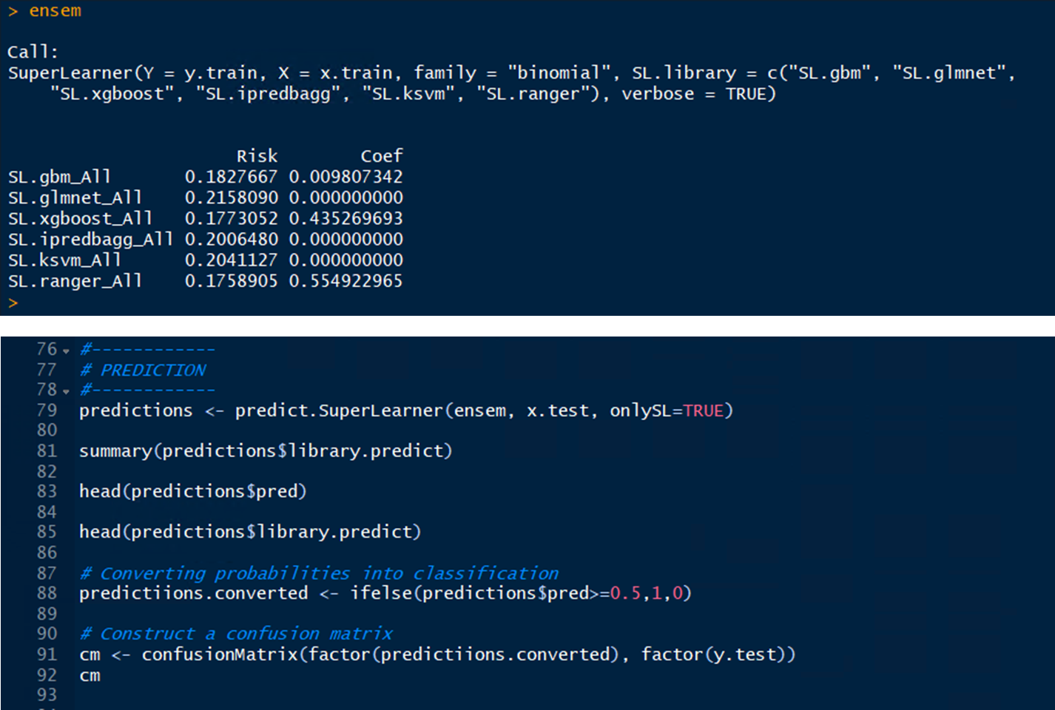

Slide 28
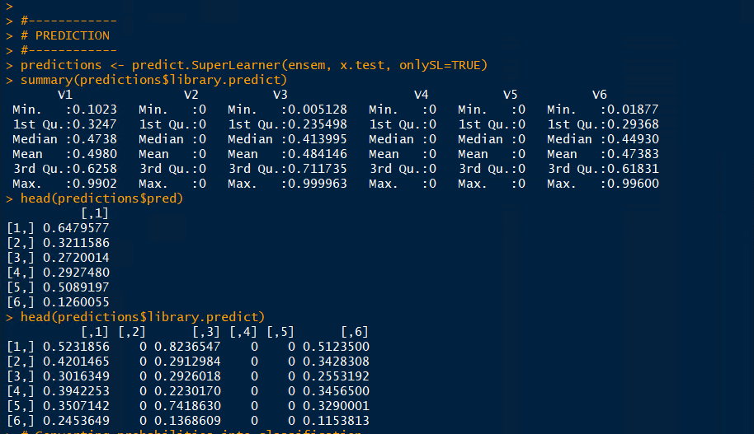

Slide 29
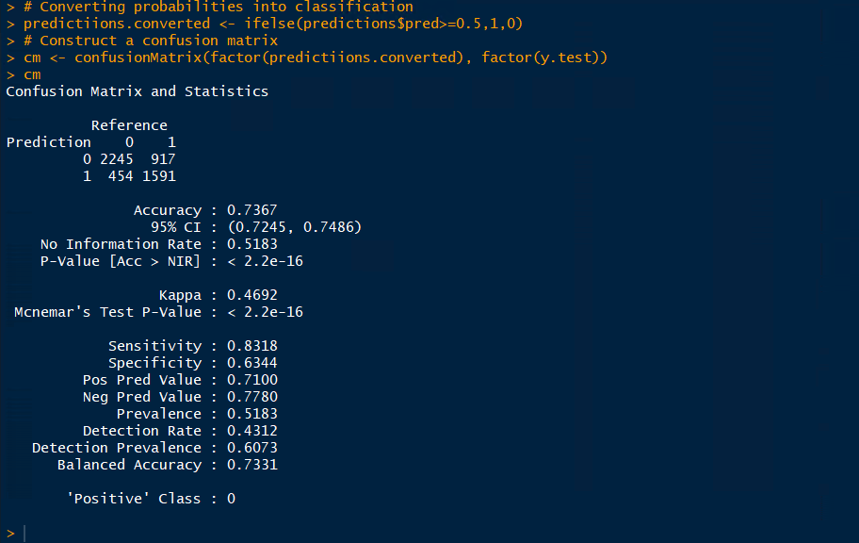

Slide 30
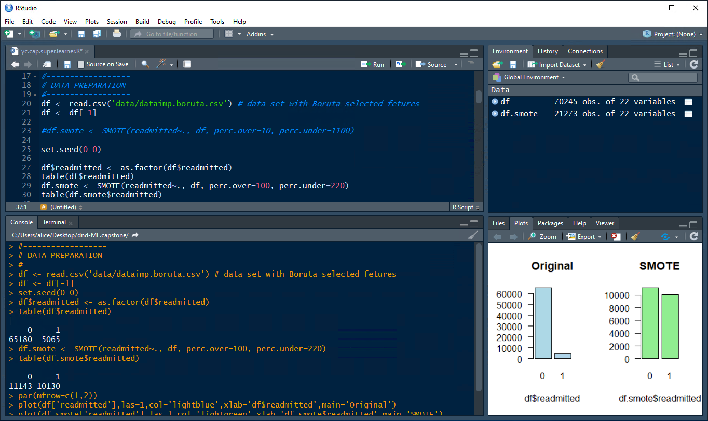

Slide 31
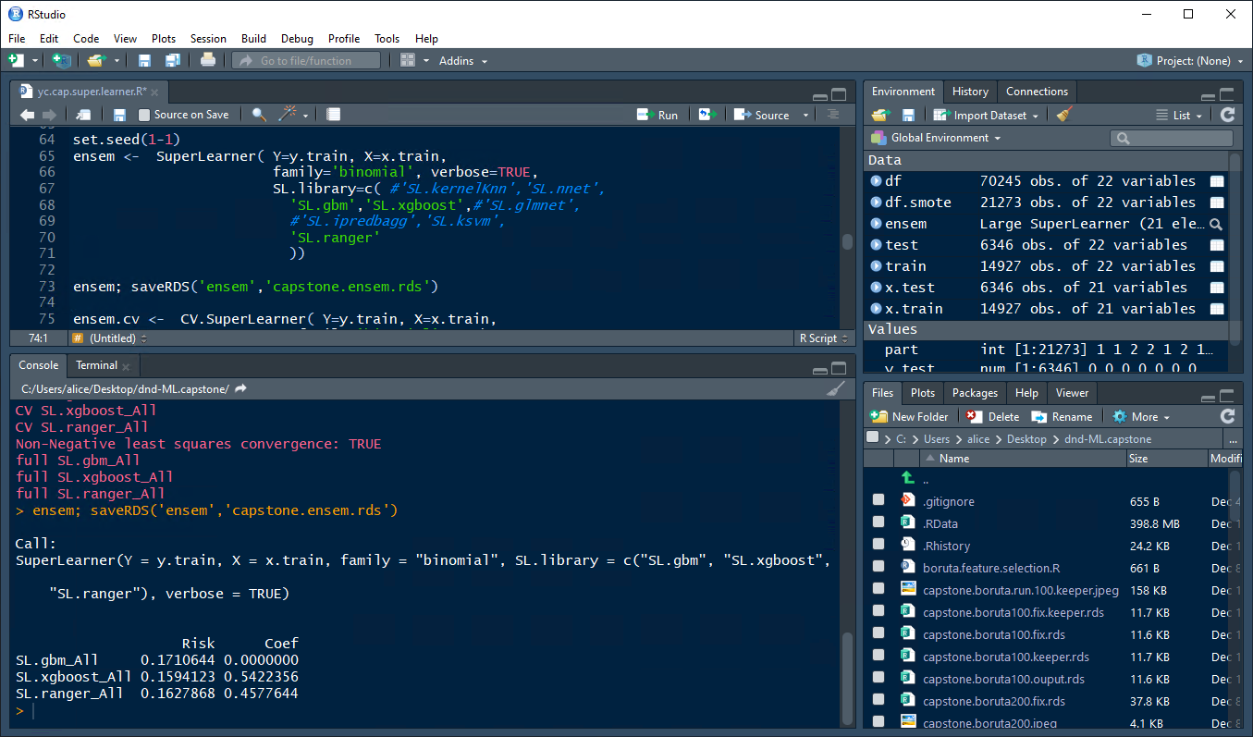

Slide 32
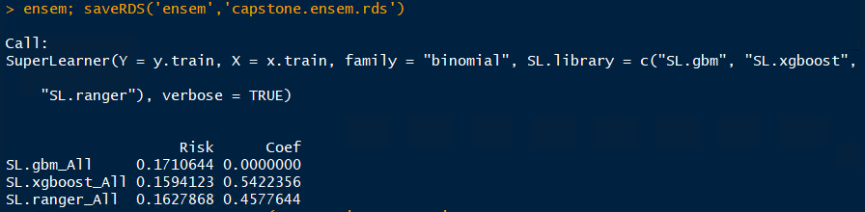
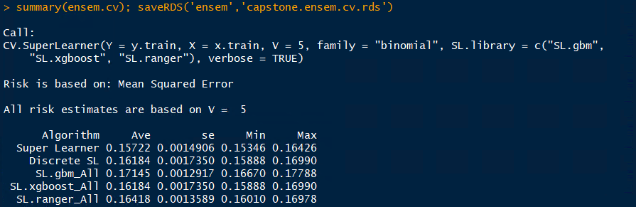
Notes:
> ensem; saveRDS('ensem','capstone.ensem.rds')
Call:
SuperLearner(Y = y.train, X = x.train, family = "binomial", SL.library = c("SL.gbm", "SL.xgboost",
"SL.ranger"), verbose = TRUE)
Risk Coef
SL.gbm_All 0.1710644 0.0000000
SL.xgboost_All 0.1594123 0.5422356
SL.ranger_All 0.1627868 0.4577644

Slide 33
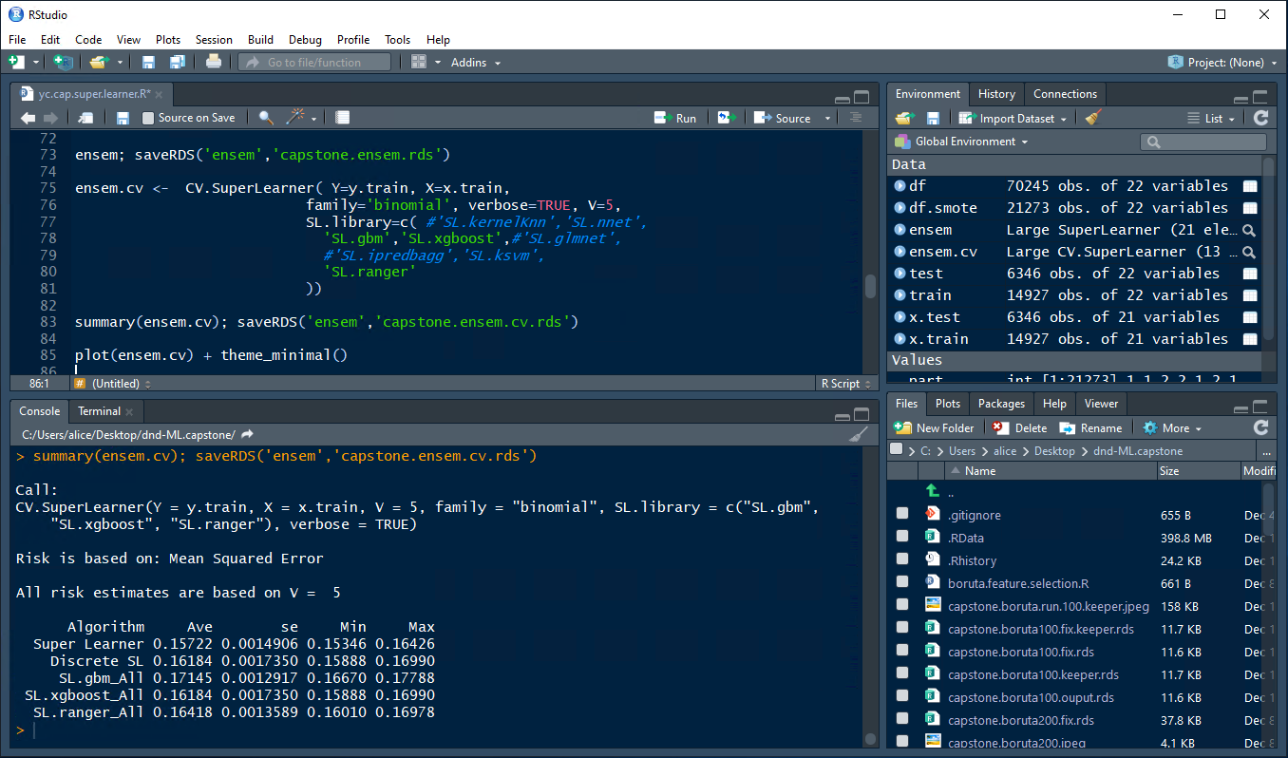
Notes:
> summary(ensem.cv); saveRDS('ensem','capstone.ensem.cv.rds')
Call:
CV.SuperLearner(Y = y.train, X = x.train, V = 5, family = "binomial", SL.library = c("SL.gbm",
"SL.xgboost", "SL.ranger"), verbose = TRUE)
Risk is based on: Mean Squared Error
All risk estimates are based on V = 5
Algorithm Ave se Min Max
Super Learner 0.15722 0.0014906 0.15346 0.16426
Discrete SL 0.16184 0.0017350 0.15888 0.16990
SL.gbm_All 0.17145 0.0012917 0.16670 0.17788
SL.xgboost_All 0.16184 0.0017350 0.15888 0.16990
SL.ranger_All 0.16418 0.0013589 0.16010 0.16978
>

Slide 34
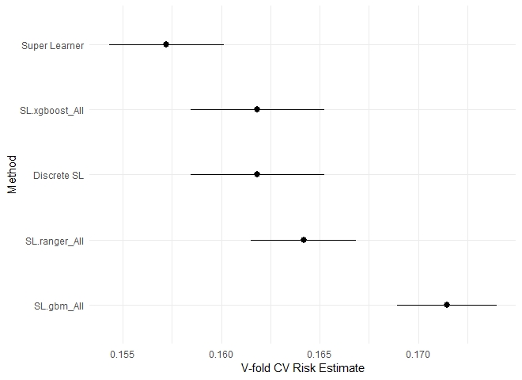

Slide 35
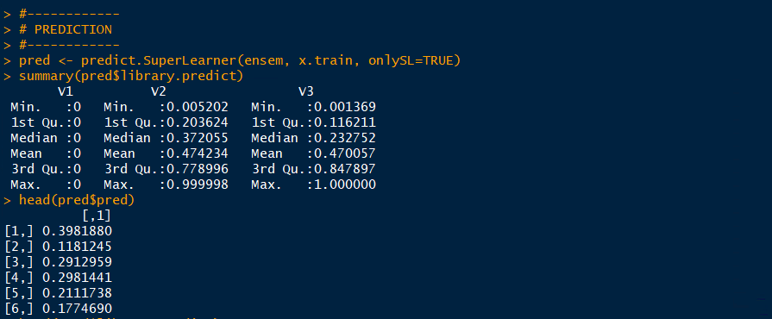
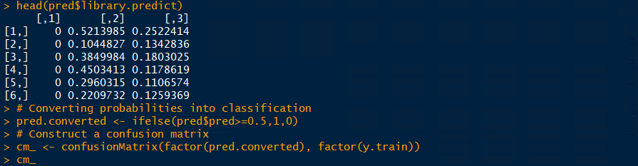

Slide 36
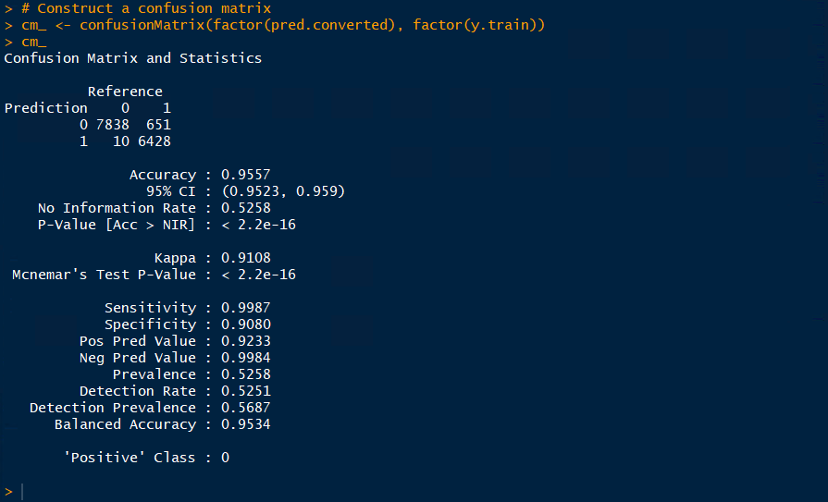

Slide 37
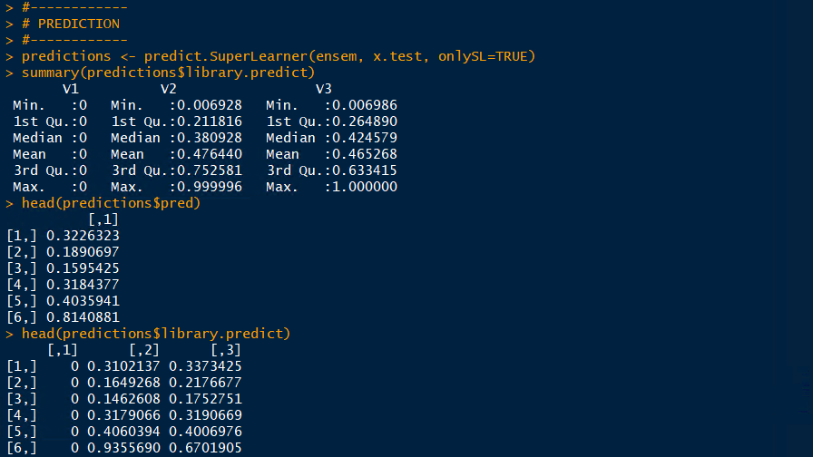

Slide 38
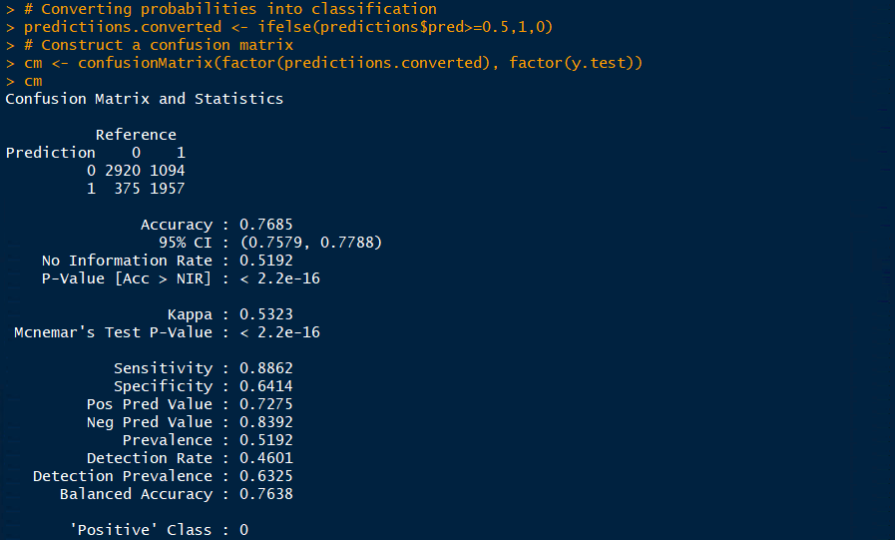

Slide 39
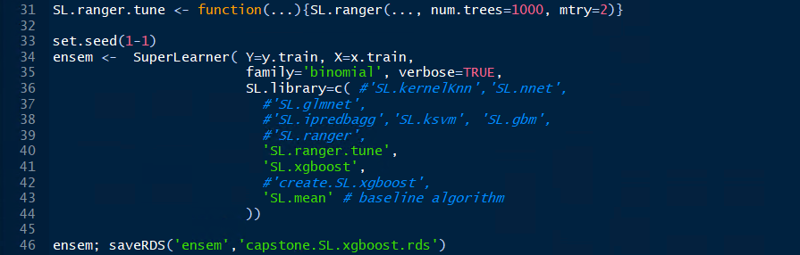
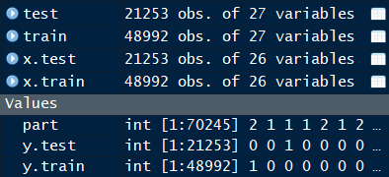

Tuning Ranger
Notes:
The training ran about 3 hours with the cloud vm,14 vcpus
not with smote data.

Slide 40


1st run
num.trees = 500
mtry = 5
V = 3

Slide 41

2nd run
num.trees = 1000
mtry = 5
V = 3

Slide 42

3rd run
num.trees = 1000
mtry = 5
V = 10

Slide 43


To SuperLearn, or Not to SuperLearn

Slide 44

To SuperLearn, or Not to SuperLearn
It was unclear if the removal was for an iteration or the entire run.
Results of a 3-hour run

Slide 45

Lessons Learned
Predicting hospital readmissions with Machine Learning
A meaningful step to solve a complex problem
It does provide some insight of the service quality and a patient’s experience
Relevant to real world problem solving and warrant mode efforts
Data cleaning is tedious, yet at the end it pays off
Hello Ranger and good-bye RandomForest
I would like to underfit something at some point of time
Hyperparameters, there’s a reason why they are call ‘hyper’
Ensemble model = practices + practices + more practices
So many tools, so little time
Pick just a few and make some lemonade

Slide 46


Slide 47



Slide 48


Slide 49


Slide 50
1st run
num.trees = 500
mtry = 5
V = 3

Slide 51
2nd run
num.trees = 1000
mtry = 5
V = 3

Slide 52
3rd run
num.trees = 1000
mtry = 5
V = 10

Slide 53


Slide 54


Slide 55


Slide 56



Slide 57



